Slide 1
An Architecture for Broadband Network Data Collection
david.zhujian@huawei.com
zhenghaomian@huawei.com
24/February 2025

Slide 2
Broadband Network Data Collection(WT-508) Scope
(1) The purpose of broadband network data collection(BNDC) :
Aim to define the data collection standards for broadband network including architecture, protocols and use cases.
(2) The scope of broadband network data collection(BNDC) includes the following aspects:
Architectural definition and description of the components of the Data Collection solution.
Specification of interfaces between the components of the Data Collection solution.
Consideration of BBF standard data objects, and vendor specific extensions to determine how they best fit in this model with little or no modification.
Main collection use cases: real-time, on-demand or streaming telemetry, bulk collection, and adaptive DC driven by some predefined strategies
Transfer protocols as suitable for different collection modes (push, pull, bulk, streaming, pub/sub)
Specification of data encapsulation mechanism(s)
Recommendations of preferred open-source tools
(3) The deliverables of broadband network data collection(BNDC) :
Technical Report, Architecture, Info/Data Model, API specifications &related marketing document or blog & Test Plans
(3) The timeline of broadband network data collection(BNDC) : start from January 2024, estimated finished in 2025.

Slide 3
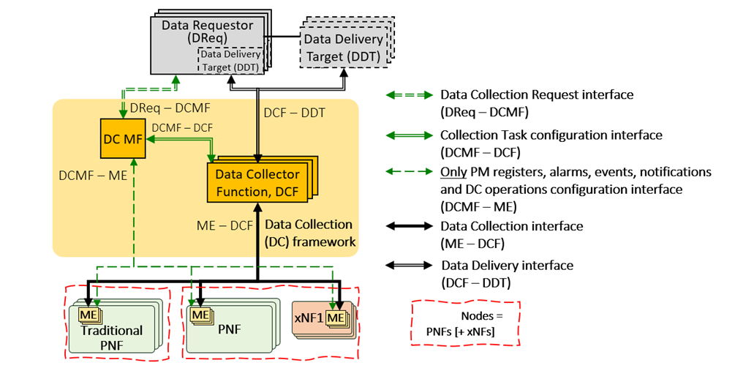
Broadband Network Data Collection(WT-508) Architecture Overview
Components | Component Name | Component Description
 | DC Management Function (DC MF) | Processing and orchestrating incoming DC requests and for managing configuration and communication tasks
 | DC Function (DCF) | Retrieving/Receiving data from the southbound network resources, performing transformations on these data, and delivering the data to the target northbound elements
 | Data Requestors (DReqs) and Data Delivery Targets (DDTs) | Data requestor and consumers, described below as Data Requestors (DReqs) and Data Delivery Targets (DDTs)
 | Managed Entities (MEs) | Managed Entities included in traditional PNF, PNF, and xNF1, which are the various kind of devices running in the network
Figure: Data Collection framework architecture of WT-508

Slide 4
Broadband Network Data Collection(WT-508) Interface Overview
Interfaces | Interface name | Interface Description
Interfaces | DReq-DCMF | Located between DC MF functional component and data requestors, this interface exposes DC framework capabilities in a Network as a Service (NaaS) manner, which receive intent-based data collection requests.
 | DCF-DDT | Located between the DCF and DDT component, this interface is designed to deliver collected data to target analysis system or databases, enabling valuable applications
 | DCMF-ME | Located between the DC MF and the management entities (MEs) functional component, this interface is used to directly subscribe the data on targeted MEs
 | DCF-ME | Located between the DCF and MEs, this interface is used to perform data collection from MEs, which facilitates the collection of data via pull, push, or telemetry modes.
 | DCMF-DCF | Located between the DC MF and DCF functional component, this interface is developed to perform the life cycle management of data collections including configuration, management, and orchestration etc.
Figure: Data Collection framework architecture of WT-508

